Slide 1



Funding and consortium building workshop
Microservices Conference, Paris
12/5-2022
12/3/2018

Slide 2
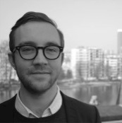




Presenter
Grøn/Bruun – Pre-award and Grant Writing
Grøn/Bruun is a R&I bureau founded in 2018. We are a partner for companies, research groups and organisations wishing to develop their research and innovation activities. We provide international networks, access to new knowledge, visibility, the option to influence, platforms for long-term collaboration and access to funding. We have 10+ years of experience with research and innovation policy in Denmark and EU. We hope to contribute to organisations’ ability to engage in international partnerships and gain access to funding. More
Christian Walther Bruun
Christian is a Board Member of Microservices Community and the Director of Grøn/Bruun a pre-award and grant writing consultancy based in Copenhagen Denmark, with clients all over Europe. Grøn/Bruun assists in developing international proposals for industry and academia with a focus on Horizon Europe and the Eurostars funding programmes. Christian has worked in the Danish Agency for Science and Higher Education, European Commission and South Denmark European Office. At these jobs he was lead or directly involved in the Horizon 2020 Interim Evaluation, FP7 Ex-Post Evaluation, Big Science Business Forum 2018, Horizon 2020 proposals, public affairs, organisational analysis of R&I as well as extensive work with communication and dissemination of research and innovation. More.
Selected experience:
Notes:
Vi for tælle begge kort om os selv

Slide 3
Content
Microservices R&I funding community group
Horizon Europe (RIA/IA/MSCA)
Eurostars
Tools and strategies
Q&A
Microservices project ideas
12/3/2018

Slide 4

Microservices Community Group on R&I funding
Microservice R&I funding group
The group will work together to identify opportunities to obtain funding aimed at developing joint projects. This will especially be focused on European funds such as Horizon Europe that supports research and innovation activities for companies, universities and organisations interested in developing joint European projects.
Activities
Online seminars of funding opportunities in Horizon 2020
Follow-up meetings on concrete project developments
Distribution of information of relevant calls and funding opportunities
12/3/2018

Slide 5
Purpose
Today
Participants will get insights into the opportunities of obtaining EU funding via the European framework programme Horizon Europe and Eurostars. These support research and innovation activities for companies, universities and organisations interested in developing joint European projects. The workshop will have two main parts:
Overview of funding opportunities relevant for microservices (MSCA, research and innovation project and Eurostars projects)
Project idea pitches and networking amongst participants
12/3/2018

Slide 6

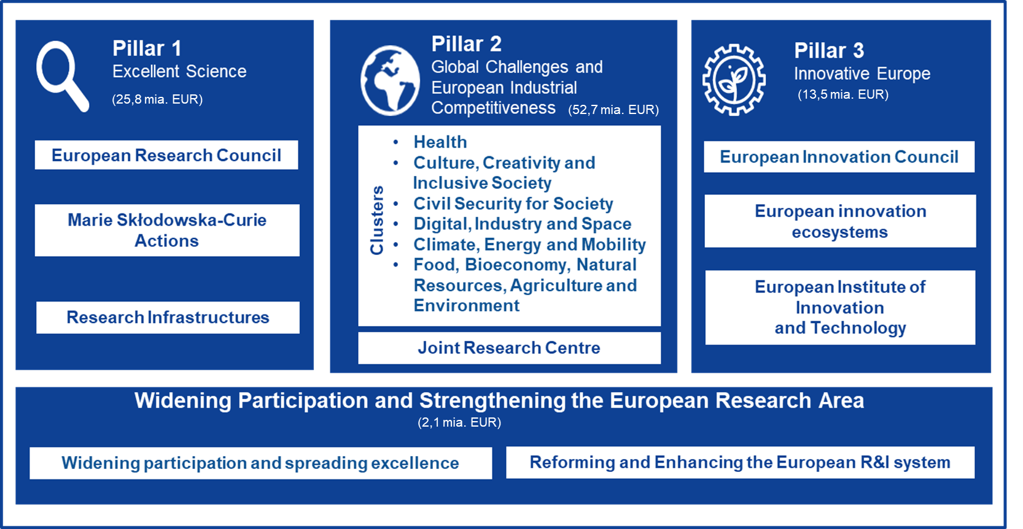
Horizon Europe
Budget €95.5 billion
12/3/2018

Slide 7


Decision structure
Mission Boards
Soil health and food
Cancer
Climate-neutral and smart cities
Healty oceans, seas, coastal and inland waters
Adaption to climate change, including societal transformation
National reference groups
Teknology platforms, PPPs
Programme committees
Alliances, networks, EIPs, P2Ps
Work Programmes
Calls and topics
Draft WP
Conferences, workshops, expert groups
DG inputs
Interservice consultation
12/3/2018

Slide 8

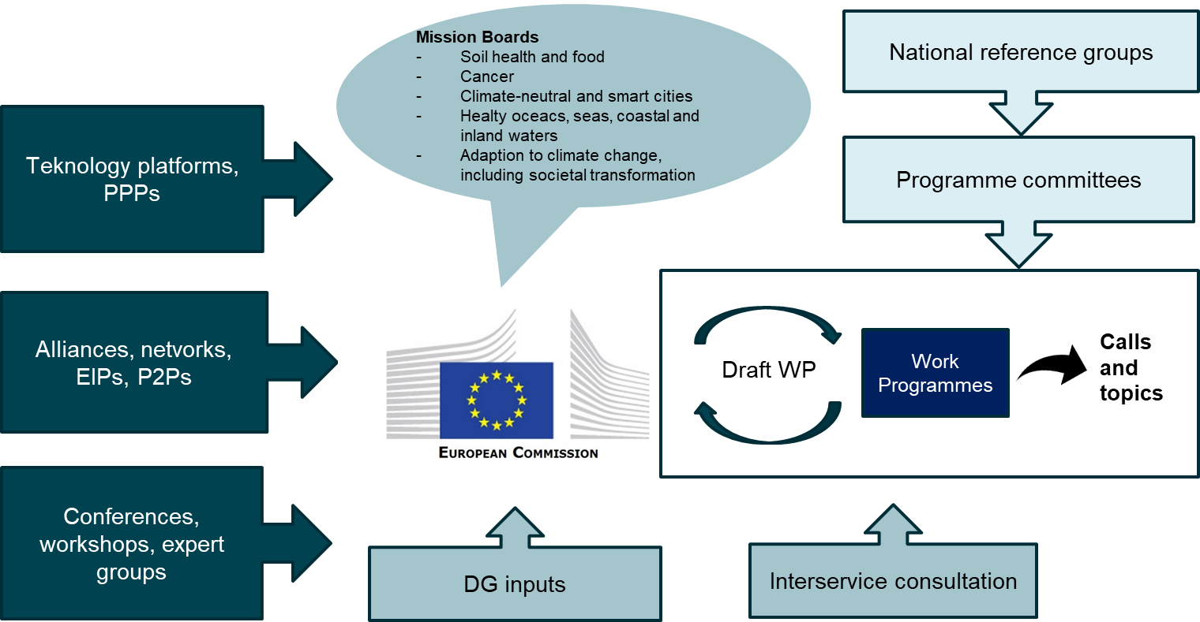
Horizon Europe
2020
2021
2022
2023
2024
2026
2027
Draft 2-year work programme
2-year work programme
Draft 2-year work programme
2-year work programme
Draft 2-year work programme
2-year work programme
12/3/2018

Slide 9
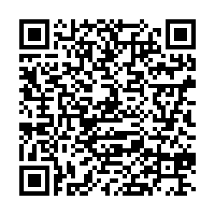
Pillar 2: Global Challenges and European Industrial Competitivenss
Grouped in six ‘clusters’ that aim at creating systemic and sustainable cange in society and the ecnomoy. These are:
Health
Culture, Creativity and Inclusive Society
Civil Security for Society
Digital, Industry and Space
Climate, Energy and Mobility
Food, Bioeconomy, Natural Resources, Agriculture and Environment
These are primarily implemented in large research- and innovation projects that answers to pre-defined challenges. Typically in consortia with universities, companies, organisations and end-users.
Link
12/3/2018

Slide 10
Research and Innovation Actions (RIA)/ Innovation Actions (IA)
PURPOSE: To secure EU’s global competitiveness and address the big societal challenges of today. Horizon Europe is a means to drive economic growth and create jobs through international, collaborative and excellent science and groundbreaking innovation. SME’s are wanted.
AMOUNT: Between EUR 0-20 mill. 70-100% funding + 25% overhead.
DURATION: 2-5 years
CRITERIA: Min. three legal entities from Horizon Europe Member States must be involved.
PROPOSAL LENGTH: Max. 45 pages + annexes
→ Supported by EUopSTART prefunding in Denmark, other schemes in e.g. Norway
12/3/2018

Slide 11
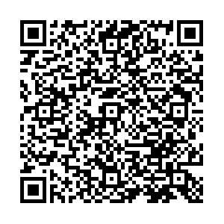
Typical project – who took my money?
A search in the EU project database CORDIS shows a total of 62 projects using ‘microservices’ (out of approx. 35,000 project).
12/3/2018

Slide 12


RADON: Broadening the software industry’s adoption of serverless computing technologies
Faster, easier and cheaper. This is how the EU-funded RADON project describes the software it will develop. With the goal of broadening the adoption of serverless computing technologies, it will apply function-level scaling and billing, automated orchestration and reuse of microservices and data pipelines. The project will test this new framework in the development of three different applications, which will include fine-grained and independently deployable microservices. Target customer segments include cloud providers, software vendors, system integrators, telecommunication providers, mobile developers and Internet of Things (IoT) vendors. The methodology will strive to tackle complexity, harmonise the abstraction and actuation of action-trigger rules, avoid function-as-a-service (FaaS) lock-in, and optimise decomposition and reuse through model-based FaaS-enabled development and orchestration.
Duration: 2019-2021
Funding: 4M EUR
Partners: Lead: Imperial College London + 10 research and industry partners from 9 countries.
12/3/2018

Slide 13

Identify existing projects
PrEstoCloud - Proactive Cloud Resources Management at the Edge for Efficient Real-Time Big Data Processing
PrEstoCloud project will make substantial research contributions in the cloud computing and real-time data intensive applications domains, in order to provide a dynamic, distributed, self-adaptive and proactively configurable architecture for processing Big Data streams. In particular, PrEstoCloud aims to combine real-time Big Data, mobile processing and cloud computing research in a unique way that entails proactiveness of cloud resources use and extension of the fog computing paradigm to the extreme edge of the network. The envisioned PrEstoCloud solution is driven by the microservices paradigm and has been structured across five different conceptual layers: i) Meta-management; ii) Control; iii) Cloud infrastructure; iv) Cloud/Edge communication and v) Devices, layers. This innovative solution will address the challenge of cloud-based self-adaptive real-time Big Data processing, including mobile stream processing and will be demonstrated and assessed in several challenging, complementary and commercially-promising pilots. There will be three PrEstoCloud pilots from the logistics, mobile journalism and security surveillance, application domains. The objective is to validate the PrEstoCloud solution, prove that it is domain agnostic and demonstrate its added-value for attracting early adopters, thus initialising the exploitation process early on.
Duration: 2017-2019
Funding: 4.3M EUR
Partners: Lead: Software AG (DE) + 10 research and industry partners from 6 countries.
12/3/2018

Slide 14
Pillar 1: Excellent science
Overall aim is to strengthen EU research and technology by investing in hihgly skilled people and cutting-edge research. This happens through:
European Research Council: Bottom-up support to individual researchers, that have written the best proposals and given the best presentation. The support is high, long-lasting and is given to high-risk/high-gain research.
Marie Skłodowska-Curie Actions: Bottom-up support to researcher mobility, education (e.g. PhD-schools across borders or as individual Post-Doc fellowships) across education and sectors..
Research infrastructure: Support to collaboration and access to research infrastructures.
12/3/2018

Slide 15
Doctoral networks
PURPOSE: To educate creative, entrepreneurial, innovative and resilient PhDs that can tackle current and future challenge. To translate knowledge and ideas to products and services for economic and societal value. Highly competitive
A consortium of organisation from different countries and sectors that propose a common research and educational programme.
Recruit researchers (PhDs) across the consortium – each researcher have their individual project.
Education in research and cross-disciplinary competences.
Common network activities
Secondments for each researcher to another sector (academic or non-academic that will cooperate).
Length: 4 year project (individual projects 3 years)
Proposal: 30 pages + annexes
Types: General/standard (max 10 PhDs), Industrial Networks – min. 50% of the time in a non-academic organisation, and Joint Networks with joint degrees awarded across organisations. (max 15 PhDs)
Funding: Set pr. number of researchers depending on their country.
Deadline: 15 November 2022
Further information: Here
Notes:
Vi for tælle begge kort om os selv

Slide 16
Postdoctoral fellowships
PURPOSE: Support to excellent researchers, undertaking international mobility. Applications will be made jointly by the researcher and a beneficiary in the academic or non-academic sector.
Increased set of research and transferable skills and competences, leading to improved employability and career prospects of MSCA postdoctoral fellows within academia and beyond;
An individual postdoc project including a new mind-sets and approaches to R&I work forged through interdisciplinary, intersectoral and international experience;
Enhanced networking and communication capacities with scientific peers, as well as with the general public that will increase and broaden the research and innovation impact.
Proposal: 10 pages + annexes
Types: European fellowships (mobility within or to Europe – 12-24 months) or Global Fellowships (mobility from Europe to outside – followed by mobility back to Europe – 24-36 months (12 months ‘back in Europe’)
Funding: Monthly allowance adjusted by a country correction depending on living cost.
Deadline: 14 September 2022
Further information: Here
Notes:
Vi for tælle begge kort om os selv

Slide 17

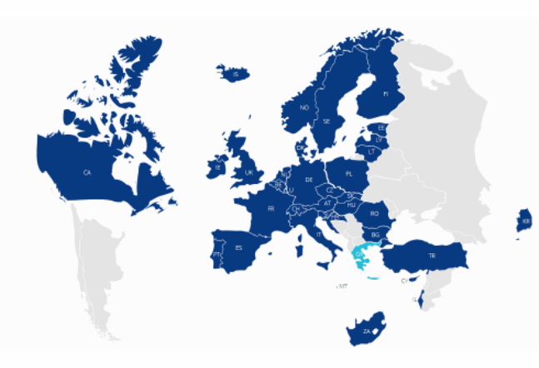
EuroStars
PURPOSE: Development of new product, service or improvement of process in business in an innovative manner with a view to stimulating economic growth and job creation. SMEs in the lead
AMOUNT: Depends on the country. In Denmark a Eurostars project is EUR 300K with a co-funding rate of 75% for Danish SMEs. Funding rate varies from country to country.
DURATION: Up to 3 years.
CRITERIA: Min. two legal entities from Eurostars Member States. Min. one must be a SME.
PROPOSAL LENGTH: 50-70 pages.
SUCCESS RATE: 15-20% (DK) / DEADLINE: Usually in February and August/September
→ Supported by EUopSTART (DK) pre-funding
See more here
12/3/2018

Slide 18
Tools and strategies - preparation
Identify what you would like to do
Identify relevant calls
Write project note
Identify partners and initiate contact
Make a timeline towards deadline
12/3/2018

Slide 19

Tools and strategies – proposal
Identify pre-funding – consultant or research support
In consortium agree on overarching purpose and structure
Develop a structured and guided application process -> writing team and areas of responsibility
Involve relevant people from institution (they might have old successful proposals etc)
Submit application
Often strong in impact, implementation and can remove must of the stress of coordination and proposal writing
12/3/2018

Slide 20
Q&A
Notes:
Vi for tælle begge kort om os selv

Slide 21
Microservices project ideas
Notes:
Vi for tælle begge kort om os selv

Slide 22


Kontakt: Christian Walther Bruun
cwb@groenbruun.eu
+ 45 53 68 89 87
www.groenbruun.eu
Join the Microservices Community R&I funding community group

